Slide 1
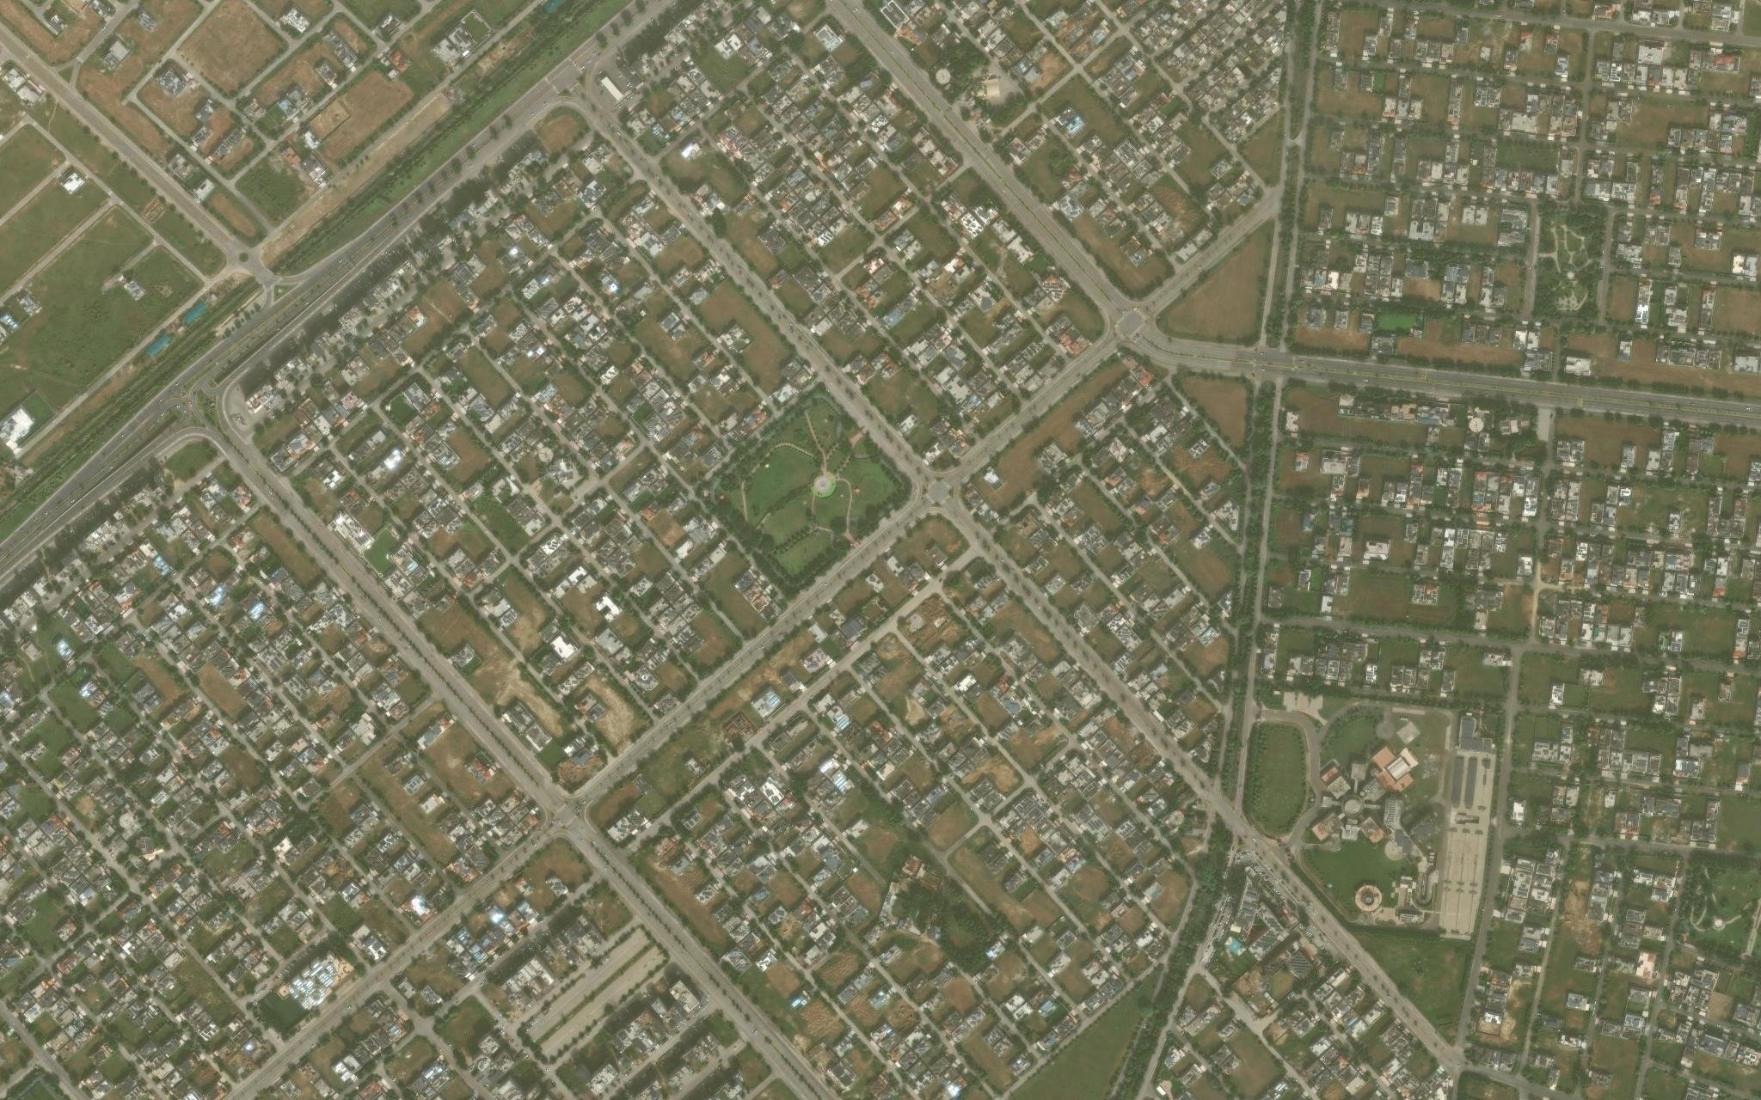
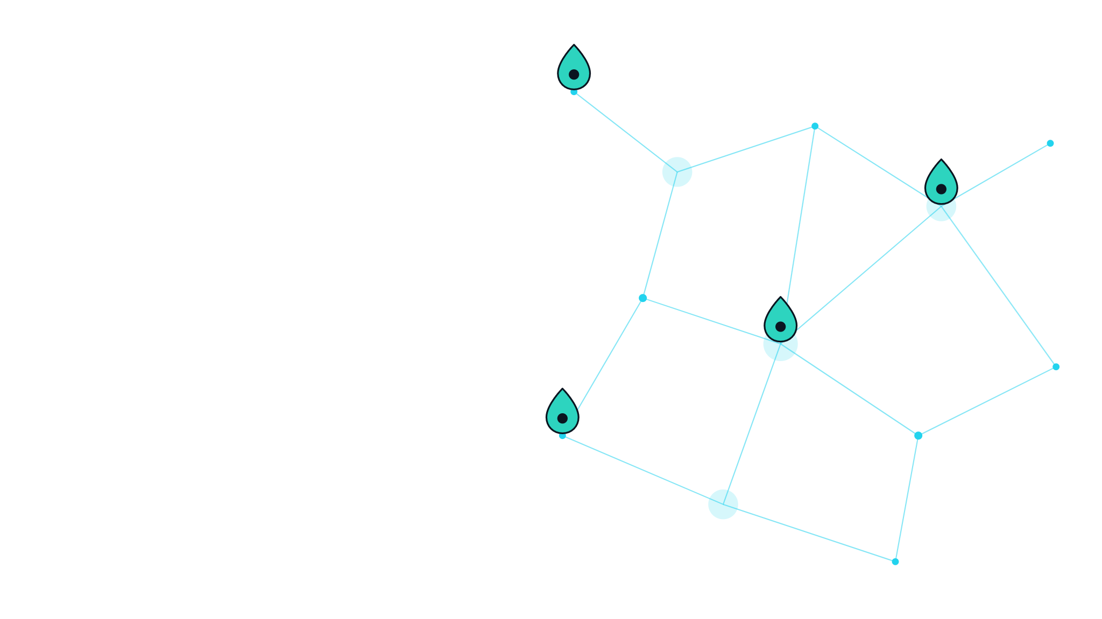

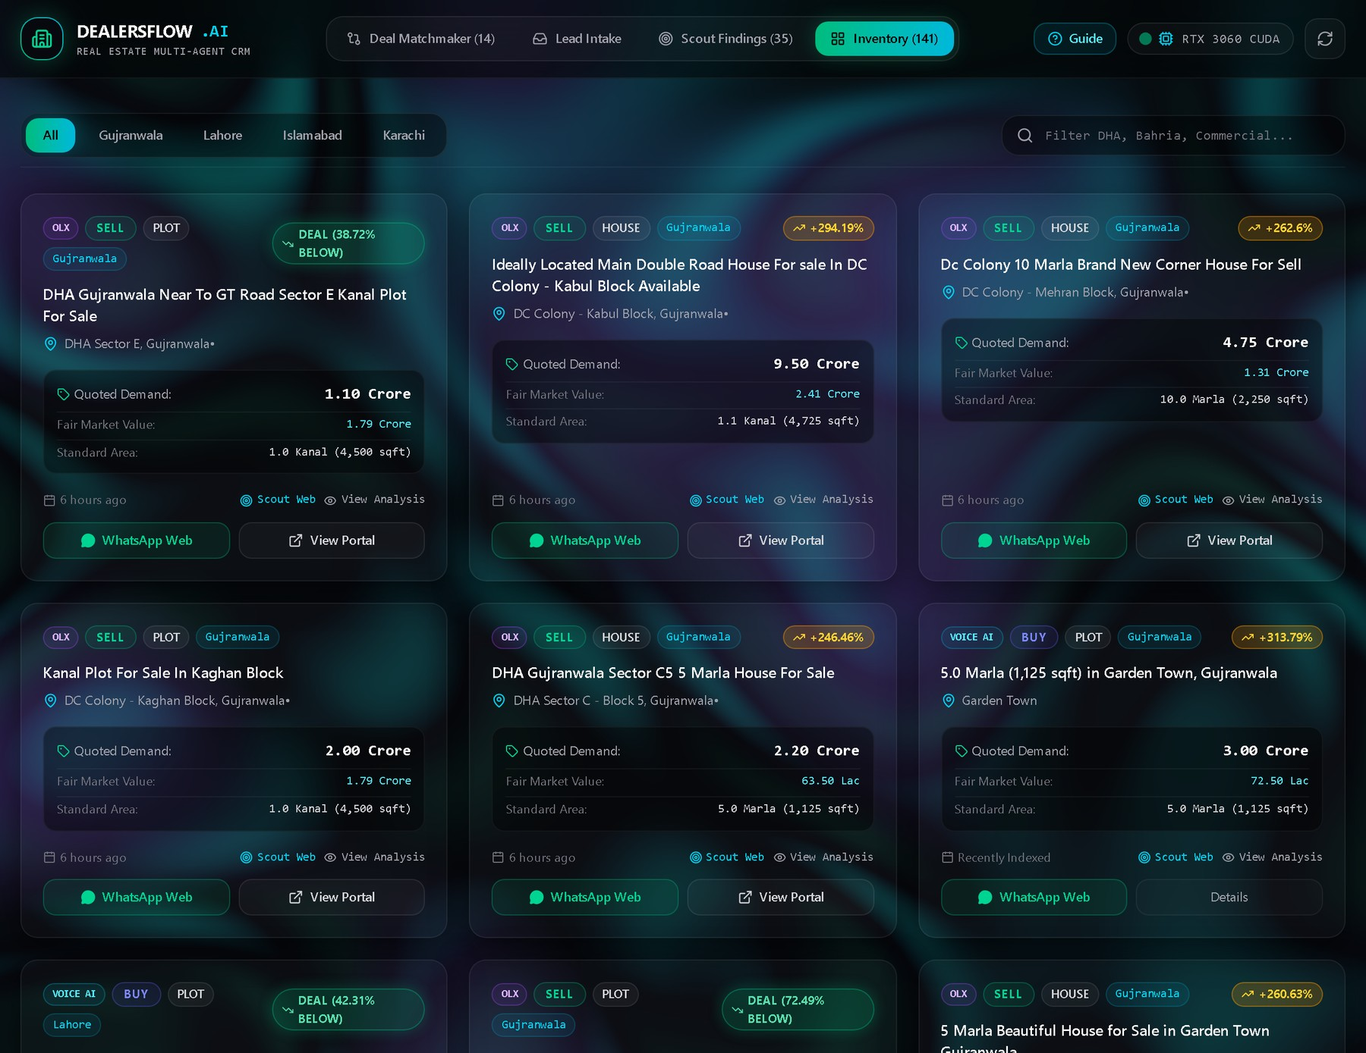
DealersFlow.AI
FINAL YEAR PROJECT PROPOSAL DEFENSE
An Autonomous Multimodal Real Estate CRM System & Market Intelligence Platform
SUBMITTED BY
Syed Muhammad Waleed Shah · 231400067
Rehan Abid · 231400109
Rehman Zahid · 231370026
Umer Afeef · 231370006
Supervisor: Faheem Rafique
BS Software Engineering · GIFT University
Our dashboard · Inventory view

Slide 2









Introduction
Dealers receive useful property information all day — but it rarely reaches an organized record.
WhatsApp messages
01
Information comes from many sources
02
Key details live in informal chats
Voice notes
DealersFlow.AI
03
Recording every inquiry takes time
Online listings
One organized property workspace
04
Buyer–seller matches are easy to miss
Manual records
Our solution: convert unstructured property information into organized records, estimate prices and match buyers with available properties.
DEALERSFLOW.AI · GIFT UNIVERSITY
02

Slide 3







Project Background
Pakistan’s property market runs on conversation, commission and trust.
WhatsApp groups
Voice notes
HOW DEALERS SAY IT → WHAT WE STORE
Listings posted all day
Details spoken, not typed
“dedh crore”
PKR 15,000,000
“dhayi lac”
PKR 250,000
Urdu · Roman-Urdu · English
Marla · Kanal · Gaz
No standard spelling
Regional land units
“1 kanal”
4,500 sq ft
“10 marla”
2,250 sq ft
Lacs · Crores
Scattered portals
Informal price terms
OLX, Zameen, Facebook
The challenge isn’t collecting information — it’s understanding it and making it searchable.
DEALERSFLOW.AI · GIFT UNIVERSITY
03

Slide 4
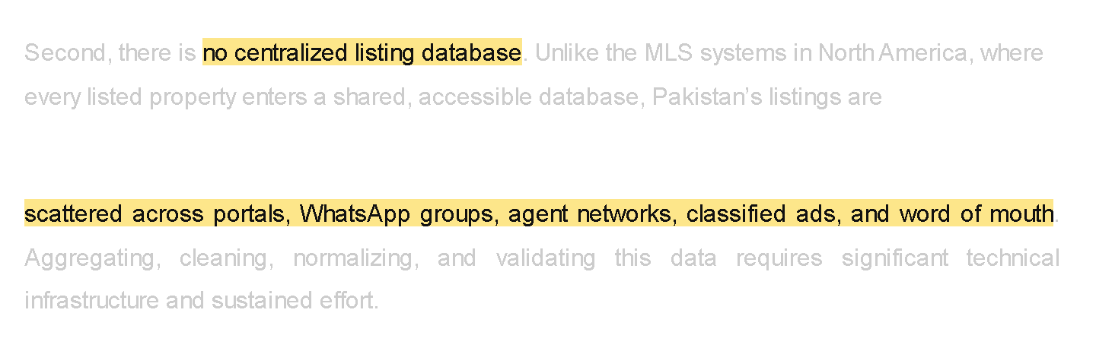
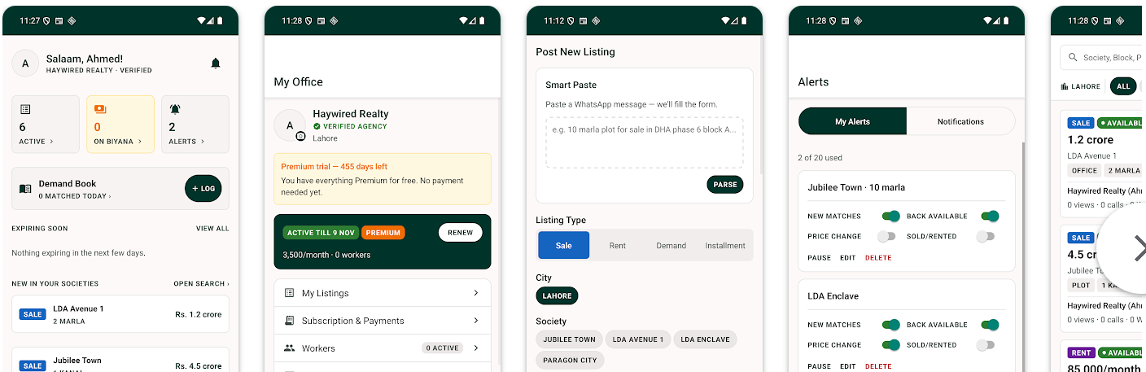
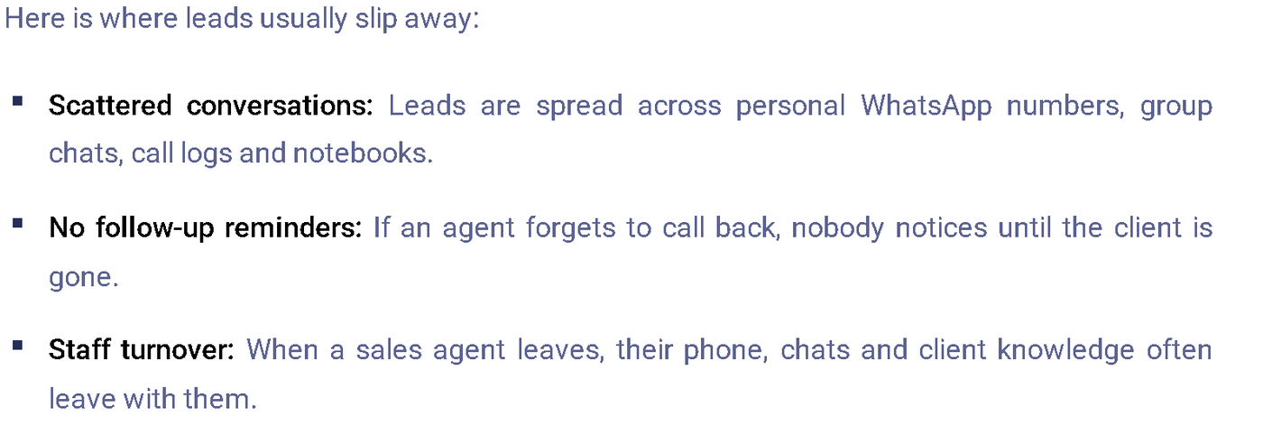
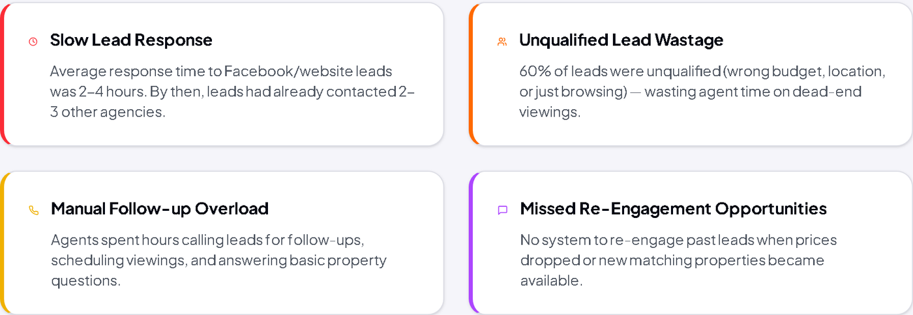
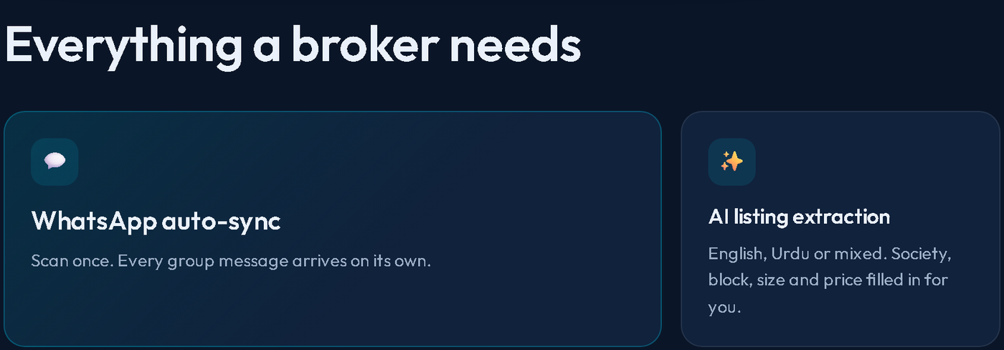
Industry Evidence & Market Activity
Listings are scattered
Dealer listing network
Leads lost in chats
No central listing database in Pakistan.
Replaces reposting in many WhatsApp groups.
Leads spread across chats, calls, notebooks.
Pakistan Today · Oct 2026
Property Share Desk · Google Play
HubSol blog · Lahore · Oct 2026
WHAT THIS SHOWS
Evidence of a real
industry problem.
Slow, manual follow-up
WhatsApp property CRM
2–4 hour response before automation.
Group sync, Urdu/mixed extraction, matching.
Local products already target WhatsApp-based property workflows.
WAB2C case study · Islamabad
Dealio · dealio.pk
DEALERSFLOW.AI · GIFT UNIVERSITY
04

Slide 5

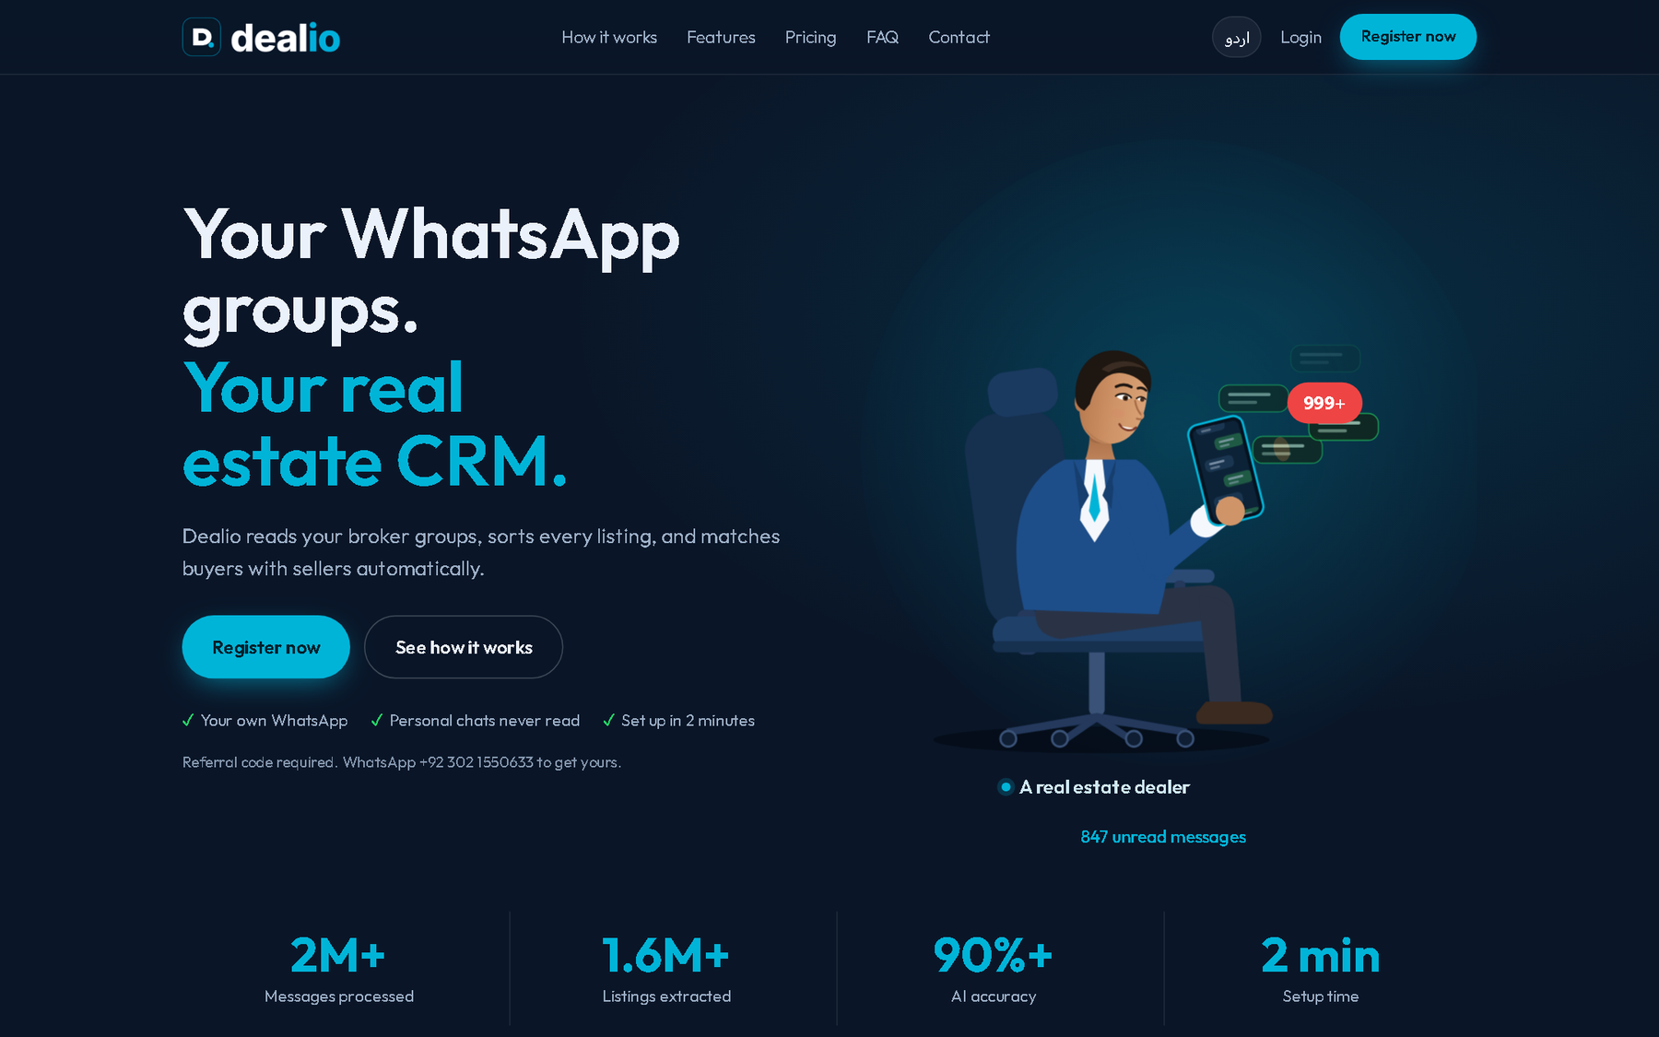
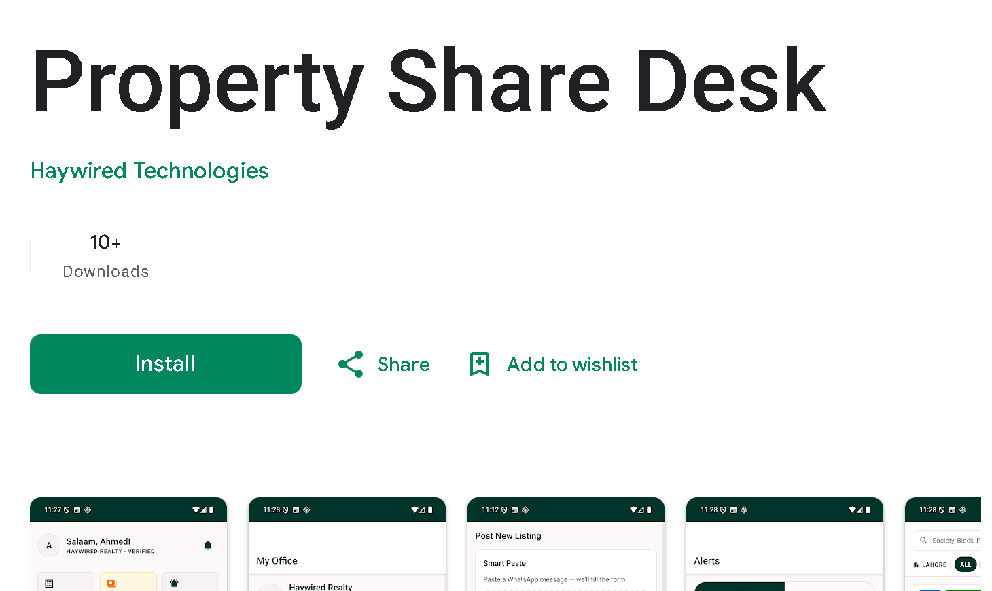
Existing Solutions & Comparison
SOLUTION
WHAT IT PROVIDES
DEALERSFLOW.AI COMBINES
Paper / Excel
Manual property and client records
Audio and chat intake
Salesforce / HubSpot
General CRM, leads and workflows
Regional language processing
ML-based valuation
Zameen / Graana
Property listings and price tools
Hybrid matching
Dealio
WhatsApp group sync, AI extraction, inventory, matching
Market discovery
Property Share Desk
Dealer listing network, demand matching, price insights
One CRM dashboard
DEALERSFLOW.AI · GIFT UNIVERSITY
05

Slide 6






Advantages & Benefits
Less Manual Entry
Faster Retrieval
Buyer–Seller Matching
Turn conversations into records without typing every field
Search properties and client requirements in one place
Find suitable properties for each buyer’s requirements
Price Estimation
Market Discovery
Dealer Control
An ML-based estimate to support price comparisons
Find extra listings from permitted external sources
Correct details and review messages before sending
Less time organizing. More time with clients.
DEALERSFLOW.AI · GIFT UNIVERSITY
06

Slide 7




Business Plan & Socio-Economic Impact
Business Plan · A Fast Cloud SaaS
Economic Impact
Made for dealers and agencies, with low running costs.
Fewer lost leads and missed commissions
No per-seat fees or paid messaging APIs
Price estimates back fairer negotiation
Fast by design
Cheap AI
Low overhead
Every action runs on the cloud
Pay-per-use AI and transcription
One shared stack, no GPU servers
CREDIT-BASED PLANS · EXAMPLE PRICING
Free
$4.99 /mo
$19.99 /mo
$99.99 /mo
Database stays free, limited use
Full access, one agent
More credits, small team
High volume, agencies
Social Impact
GO-TO-MARKET · SELL THE RESULT, NOT THE SOFTWARE
Works in Urdu and Roman-Urdu
Brings small dealers into digital tools
Clearer prices for buyers and sellers
“The dealer using this will replace you.”
WhatsApp groups & dealer referrals
Free tier
Paid plans
DEALERSFLOW.AI · GIFT UNIVERSITY
07

Slide 8
Business Model Canvas
Example pricing · a proposed model
KEY PARTNERS
KEY ACTIVITIES
VALUE PROPOSITIONS
CUSTOMER RELATIONSHIPS
CUSTOMER SEGMENTS
Cloud AI & transcription APIs
Cloud hosting & database
Property portals, within their terms
WhatsApp dealer groups (outreach)
Open-source tools
Build AI pipeline & dashboard
Train valuation model
Test with users, improve
Voice & chat → organized records
Urdu, Roman-Urdu, local units
Automatic buyer–seller matching
ML price estimate
Fast, affordable, phone-ready
Independent dealers
Small agencies & teams
Large agencies & dealer groups
Lahore, Islamabad, Gujranwala, Karachi
Early adopters: WhatsApp-group dealers
Self-service dashboard
Guided onboarding
Support over WhatsApp
KEY RESOURCES
CHANNELS
Team: backend, ML, NLP, UI
Cloud stack & AI APIs
Listing data & trained model
WhatsApp dealer groups
Dealer referrals
Online demos
COST STRUCTURE
REVENUE STREAMS
Pay-per-use AI APIs
Shared cloud stack & DB
No GPU servers
Free tier (limited)
$4.99 agent
$19.99 team
$99.99 agency
Marketing & support
Development
Monthly credits
DEALERSFLOW.AI · GIFT UNIVERSITY
08

Slide 9




Project Scope
In Scope
Out of Scope
Audio and chat processing
Buyer–seller matching
– Payments and escrow
Urdu, Roman-Urdu, English
External listings (OLX, Zameen)
– Patwari / registry
Property detail extraction
Dashboard + WhatsApp
– Mass-messaging bots
Currency and unit conversion
Local and mobile deployment
ML price estimation
The dealer reviews everything before it is sent.
DEALERSFLOW.AI · GIFT UNIVERSITY
09

Slide 10


Core Modules · 1–3
01
02
03
Audio Ingestion
Extraction & Normalization
Price Valuation
Voice notes and live mic become text.
Messy text becomes structured fields.
Estimates price and flags outliers.
LLM extracts location, size, price, intent
Deterministic rules convert units and prices
Learns from location, size and type
Returns an estimate plus a price range
FFmpeg standardizes the audio
Whisper transcribes; VAD trims silence
Qwen3.5:9B
Gemini 3.8 Flash
Pydantic
FFmpeg
Faster-Whisper
CatBoost
Price range
VAD
Illustrative example, not an actual prediction
Location
DHA Phase 6
“DHA Phase 6, 1 kanal plot, dedh crore demand.”
Model estimate
Asking price
Size
4,500 sq ft
1.85 Cr
2.00 Cr
Price
PKR 15,000,000
● Potentially below estimate
Audio
→
Process
→
Text
Type
Plot
Requires further verification and comparable property data.
DEALERSFLOW.AI · GIFT UNIVERSITY
10

Slide 11
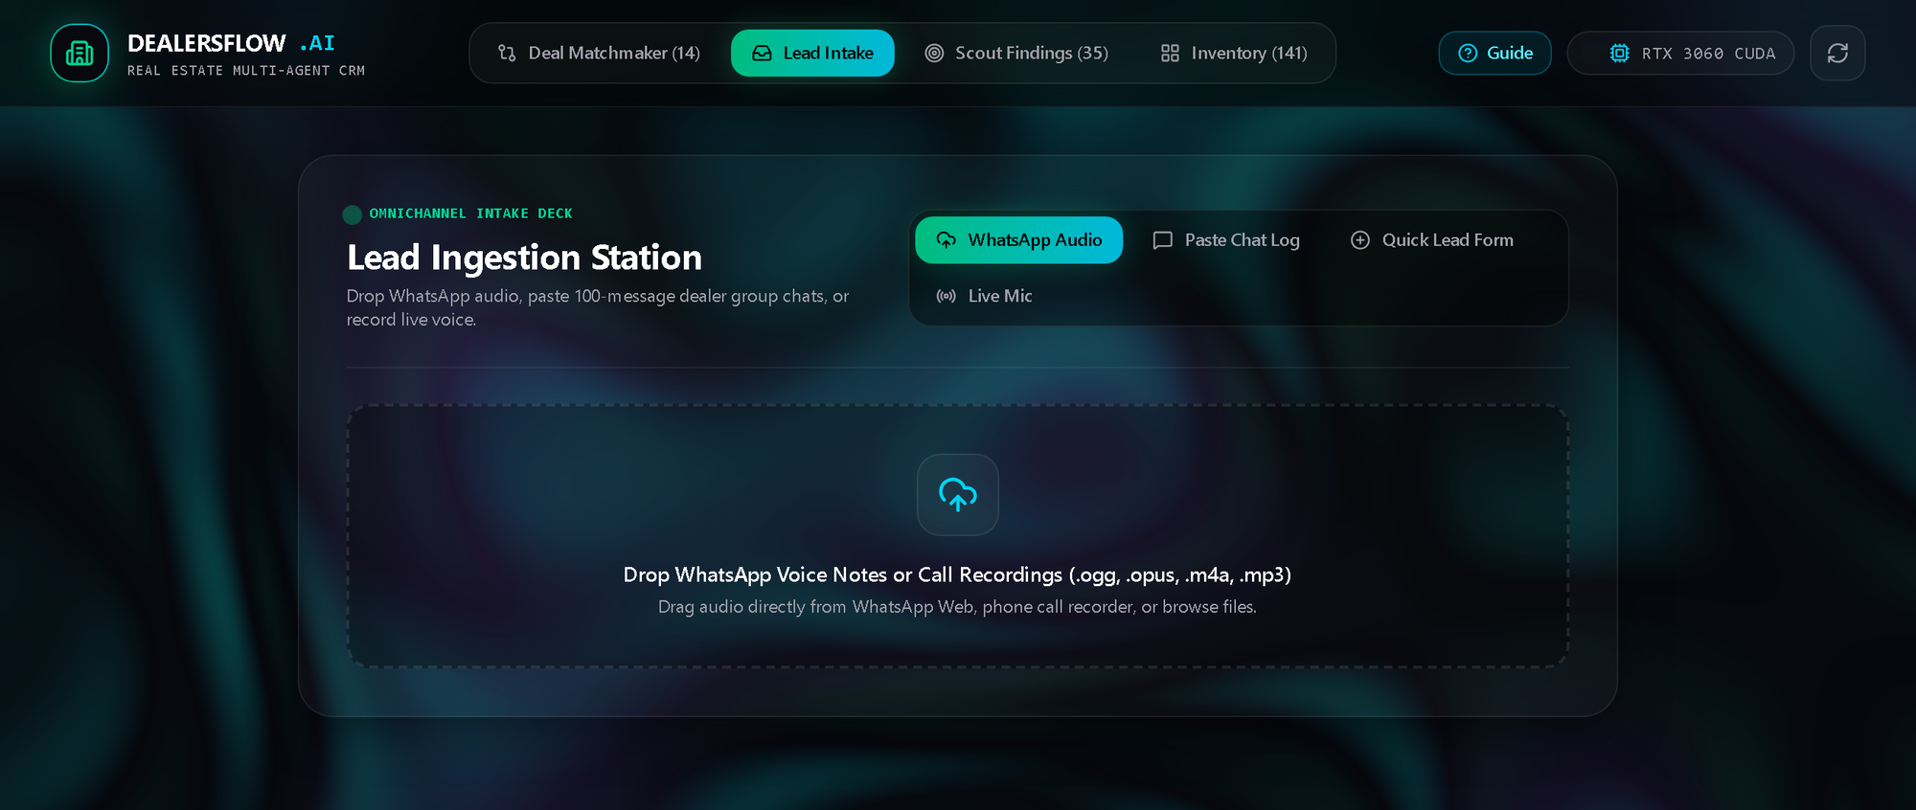





Core Modules · 4–6
04
05
06
Hybrid Matching
Web Scouting Agent
Dashboard & WhatsApp
Filter first, then rank by meaning.
Finds more listings from external sources.
One workspace for leads, inventory and matches.
SQL removes listings outside requirements
Embeddings rank the rest by relevance
Searches and collects permitted listings
Circuit breakers and request delays
Deal Matchmaker, Lead Intake, Inventory
One-click WhatsApp message prep
Buyer: 1 Kanal · DHA 6 · 2 Cr
Search · DuckDuckGo
SQL filter · PostgreSQL
Collect · Playwright
Semantic rank · pgvector
Log · audit trail
Next.js
WhatsApp links
Best matches
Follows each site’s rules
Chrome extension
DEALERSFLOW.AI · GIFT UNIVERSITY
11

Slide 12





Limitations & Constraints
LIMITATION
WHY
OUR APPROACH
Audio quality
Noise and muffled speech lower accuracy
VAD, preprocessing, manual correction
Language & dialect
Mixed languages, inconsistent spelling
Vocabulary prompts and normalization
External websites
Layouts change; access can be restricted
Rate limits, circuit breakers, fallbacks
Hardware
Several models can exceed GPU memory
Sequential queue and API fallback
Valuation accuracy
Asking prices aren’t final sale prices
A guide, not an official valuation
Integrations also depend on platform terms, API quotas and device testing.
DEALERSFLOW.AI · GIFT UNIVERSITY
12

Slide 13






Tools & Technologies
Frontend & User Interface
Next.js 16
React 19
Tailwind CSS 4
Web Audio API
Backend & API
Python 3.11
FastAPI
SQLAlchemy
Asyncpg
Pydantic v2
AI, NLP & Machine Learning
Faster-Whisper
Qwen3.5:9B
Gemini 3.8 Flash
CatBoost
EmbeddingGemma 2
LangGraph
Database & Retrieval
PostgreSQL
pgvector
Processing, Automation & Mobile
FFmpeg
Silero VAD
Playwright
Chrome Extension
Termux
Edge for Android
ARCHITECTURE
Frontend
FastAPI
AI / ML
PostgreSQL + pgvector
DEALERSFLOW.AI · GIFT UNIVERSITY
13

Slide 14





Problem Definition
01
02
Lost Deals
Voice & Chat Friction
Buyer requirements and listings get buried in chats, so good matches are missed.
Voice notes and chats mix languages, local units and background noise.
PROPERTY INFORMATION PROBLEMS
03
04
Uncertain Pricing
Scattered Inventory
Sellers overestimate, buyers lowball — and there’s no quick, objective price check.
Listings are spread across portals, dealer groups and notebooks — hard to compare.
DEALERSFLOW.AI · GIFT UNIVERSITY
14

Slide 15




Team Specializations
Syed Muhammad Waleed Shah
Rehman Zahid
Backend & ML
Frontend & UI/UX
Backend architecture and database
CatBoost property valuation
Data collection and web scouting
Next.js dashboard and interface design
WebGL and audio visualizations
WhatsApp companion extension
Rehan Abid
Umer Afeef
AI Workflow & Integration
Speech & NLP
LangGraph orchestration
Agent coordination and error handling
WhatsApp outbound integration
Speech recognition and audio processing
Urdu and Roman-Urdu understanding
Extraction, normalization and embeddings
DEALERSFLOW.AI · GIFT UNIVERSITY
15

Slide 16



Expected Outcome
Scattered property information → organized, searchable intelligence.
INPUT
PROCESS
ORGANIZE
RESULTS
Audio & chat
AI extraction
Inventory
Prices & matches
EXPECTED DELIVERABLES
Integrated CRM prototype
Audio & chat processing
Price estimation & matching
Dashboard + documented evaluation
Thank You
Questions & Discussion
DEALERSFLOW.AI | GIFT UNIVERSITY
16

